Slide 1

H5P and Learning Locker
Michael Potter Educational Technologist Office of Digital Learning Eberly College of Science
Glenn Johnson Instructional Designer Department of Statistics Eberly College of Science

Slide 2

What is H5P?
H5P is interactive, mobile friendly HTML5 content that you can embed in your course materials.
https://h5p.org/
What does it provide to the learning environment?
Engaging, highly focused content
questions (image hotspots, MC, T/F, fill in the blank)
study cards (timelines)
games
Video (interactive video)
Low stakes self-check tools for instant feedback for students (and instructors)
Examples

Slide 3

What is Learning Locker?
https://learninglocker.net/
Learning Locker is an application that tracks data related to learning.
Built on the Tincan API which is designed specifically to track learning experiences.
Can help track student responses over time to improve course content.
H5P sends out statements related to student responses.
Can we use Learning Locker to read these?
Examples

Slide 4
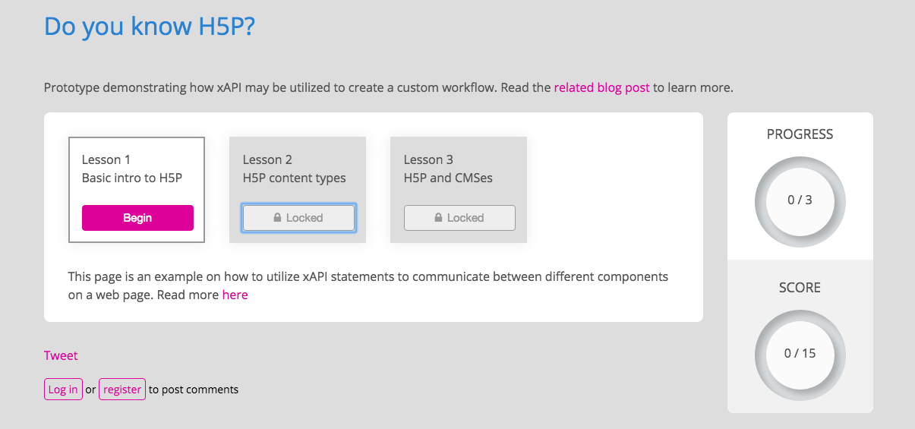
Future Directions
Individualized student progress / workflow through courses.
Gamification, unlocking achievements, badging
Example: H5P Custom Workflow Demo

Slide 5
Questions?
Michael Potter - mgp140@psu.edu
Glenn Johnson – gfj100@psu.edu

